Slide 1


Why
Cambridge?

Slide 2





Cambridge International
Education
A part of the University of Cambridge
We work in 160 countries and more than 10K schools worldwide
160-year history of providing international exams, with the largest research dept. of any international board
The world’s largest provider of international qualifications for 3–19-year-olds
Together we shape the learners who shape the world.

Slide 3

Cambridge Pathway: Prepares students for life
Cambridge
Pathway
A clear path for educational success from age 3 to 19
Cambridge Early Years
Age 3+
Cambridge
Lower Secondary
Age 11+
Cambridge
Upper Secondary
Age 14+
Cambridge Advanced
Age 16+
Cambridge Primary
Age 5+
Cambridge Professional Development for teachers and school leaders

Slide 4
Preparing learners to thrive
in a changing world
Cambridge recently completed a worldwide study on –
"How Ready are the Learners for the Future"
cambridge.org/future-ready-learners

Slide 5
Insights from over 7000 voices from 150 countries
3,021
3,840
50
150
Teachers
Students
Education Experts
Countries
who teach students aged 14–19 years
Aged 16–19 years
From leading organisations
represented

Slide 6



Key themes emerge from the research
1
2
3
Readiness for the future
Self-management
Subject Knowledge & Skills

Slide 7
Key themes emerge from the research
1
Readiness for the future

Slide 8
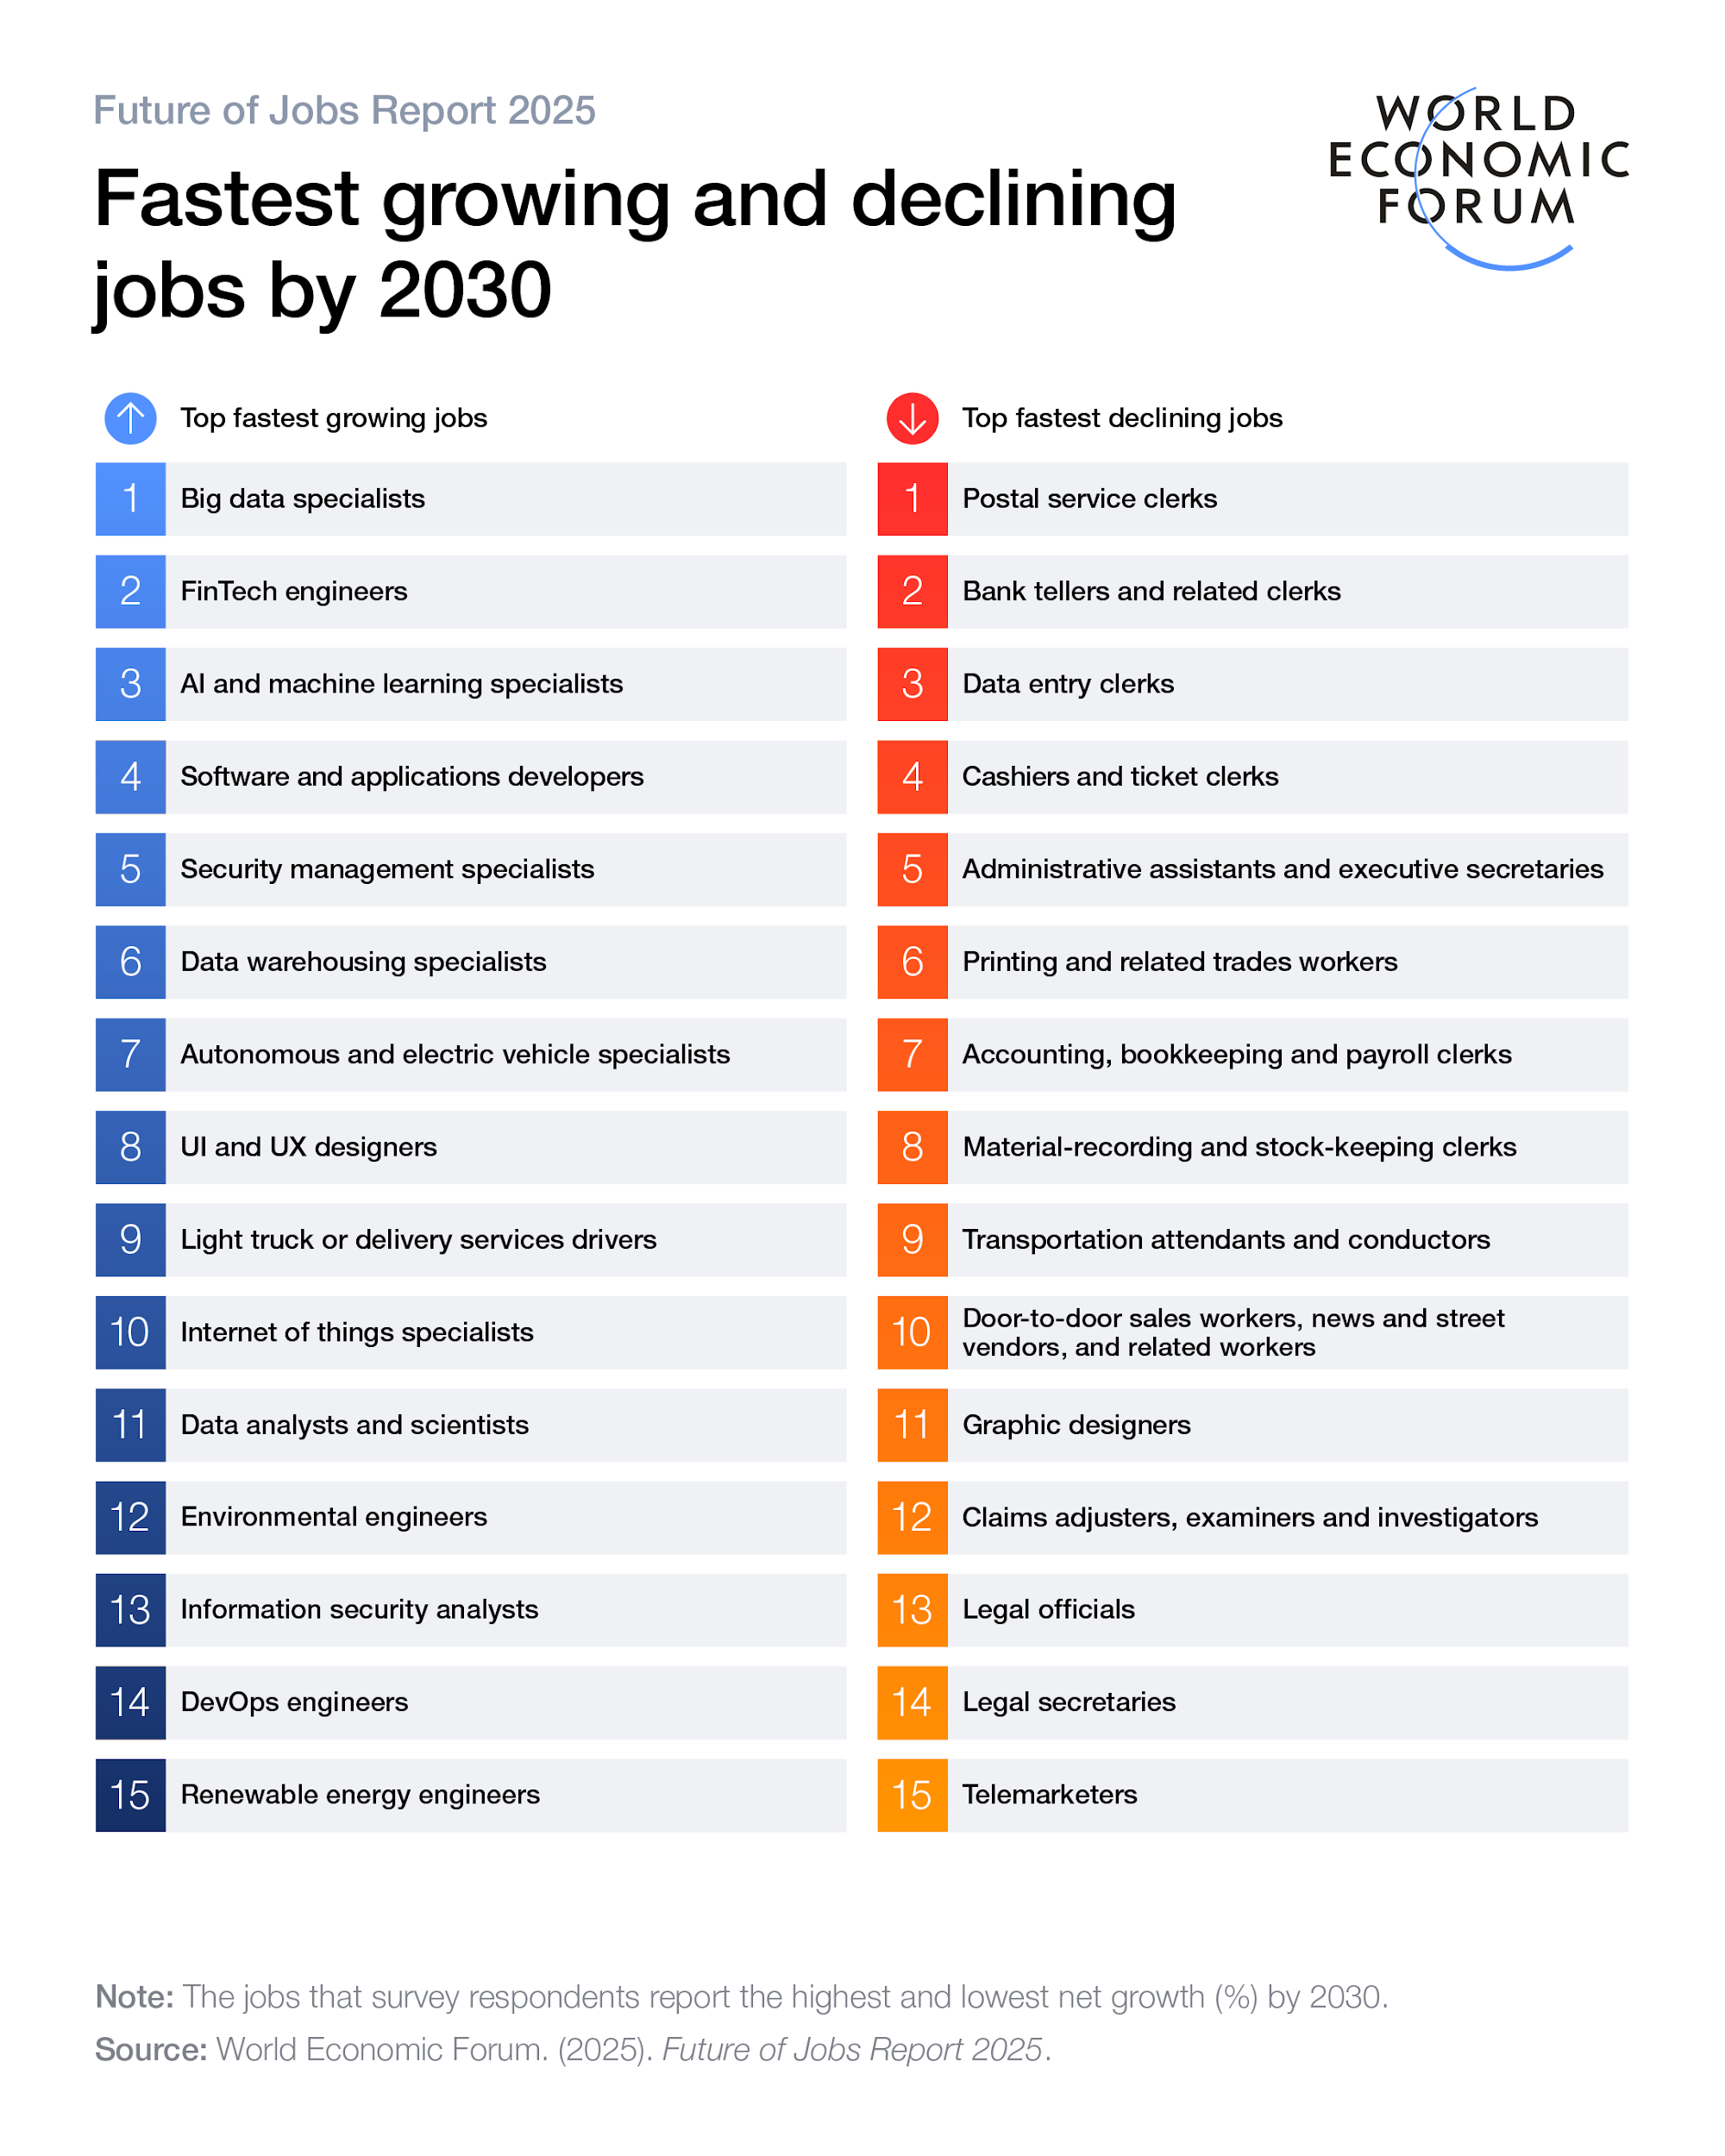

What Does the Future Look Like?
Careers and industries are evolving faster than ever
170M
New jobs created globally
by 2030
World Economic Forum
92M
Existing roles will be
displaced
World Economic Forum

Slide 9
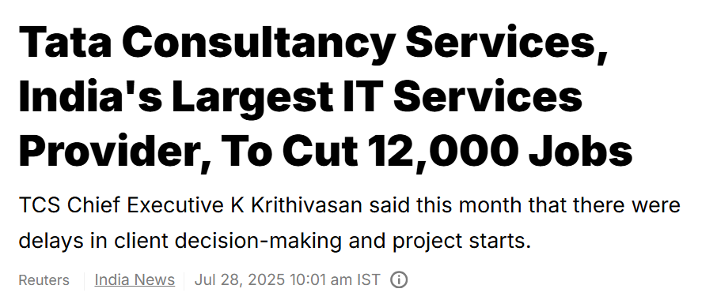

And the future is here!

Slide 10


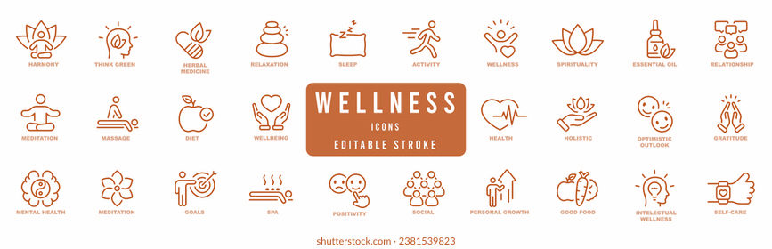




Readiness for the Future
Students are more prepared than
they think they are
What Should Schools Focus On?
Top 3 future readiness priorities selected by students and teachers globally
Thinking/ Life Skills
Love for Learning
67% of teachers believe that students are better prepared for next step in education while only 48% of students feel the same
Emotional Wellbeing
Thinking/ Life Skills
Career Readiness
59% of teachers believe that students are better prepared for future after education as compared to only 45% of students
Entry to Higher Education

Slide 11
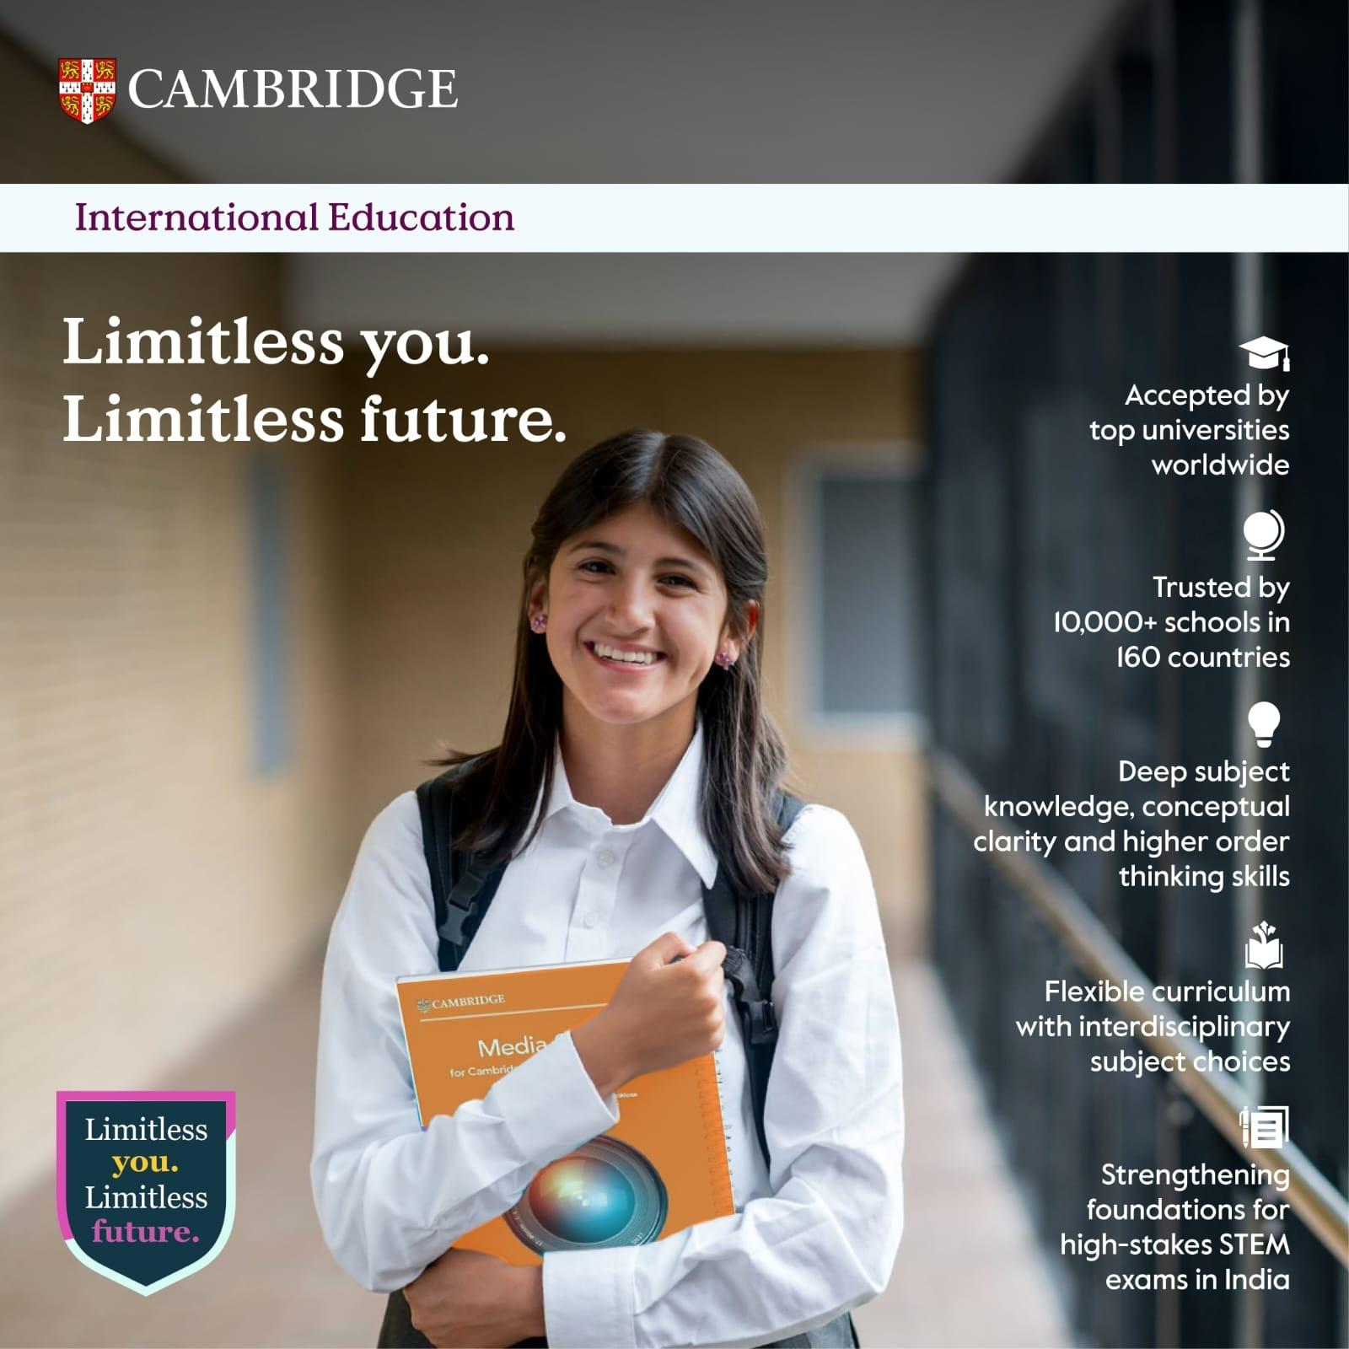
A part of the University of Cambridge
160-year history of providing international exams, with the largest research dept. of any international board
How does Cambridge prepare you?
The world’s largest provider of international qualifications for 3–19-year-olds
Notes:
The Cambridge Learner has been prepared for a changing world. While our curriculum is Flexible with various Interdisciplinary choices available for students at different stages.And the options are open for the Learners in India and Abroad. The hallmark of the CI curriculum has been its emphasis on Deep Subject Knowledge, Conceptual Clarity and its emphasis on Higher Order Thinking Skills. The Cambridge Learners across 10,000 + schools in 160+ countries are accepted by the Top Universities across the World.

Slide 12
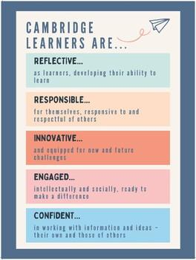

Together we shape the learners who shape the world.

Slide 13
Key themes emerge from the research
2
Self-management

Slide 14
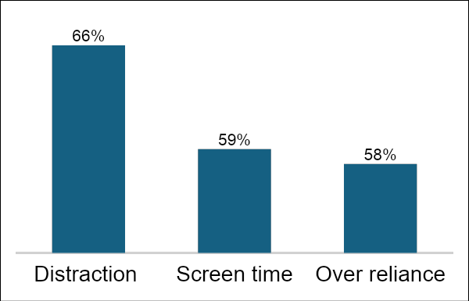
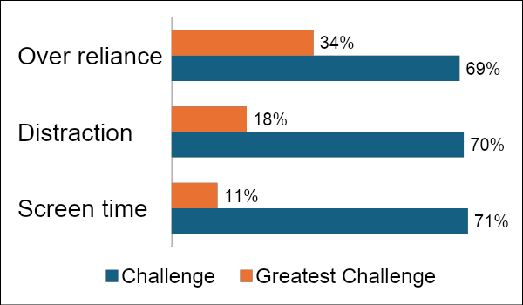
Self Management
Student worries about technology
Self-management seen as essential skill for future success,
but one of the hardest to learn & teach
19%
23%
Students believe it's the
most difficult skill to learn
Teachers say it's the most
difficult skill to teach
Teachers' greatest concerns
88%
~72%
of teachers say attention
spans are getting shorter
report reduced ability to
sustain focus on complex topics

Slide 15
Key themes emerge from the research
3
Subject Knowledge & Skills

Slide 16
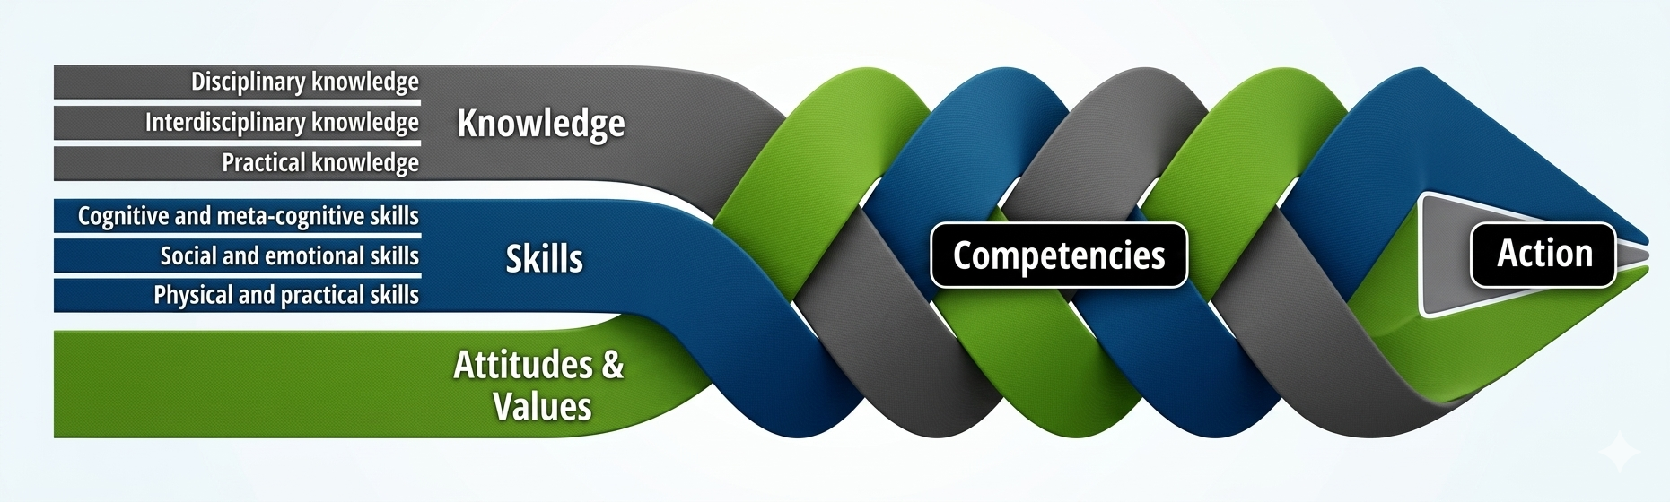
"Future-ready students need to apply knowledge creatively and ethically in unfamiliar situations."
— OECD 2030 Learning Compass

Slide 17
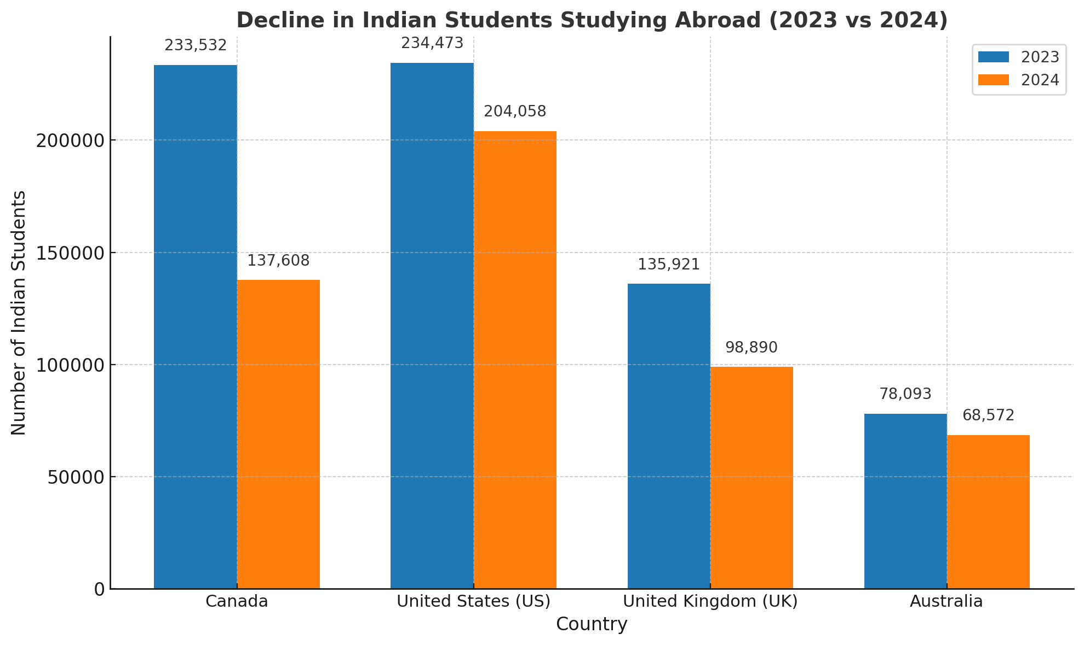



Countries that looked attractive before for students –may not be so now
Top 3 Emerging International Destinations
1
2
3
Germany
Australia
Singapore
Indicative figures for illustration; compiled from publicly available visa and enrollment data

Slide 18
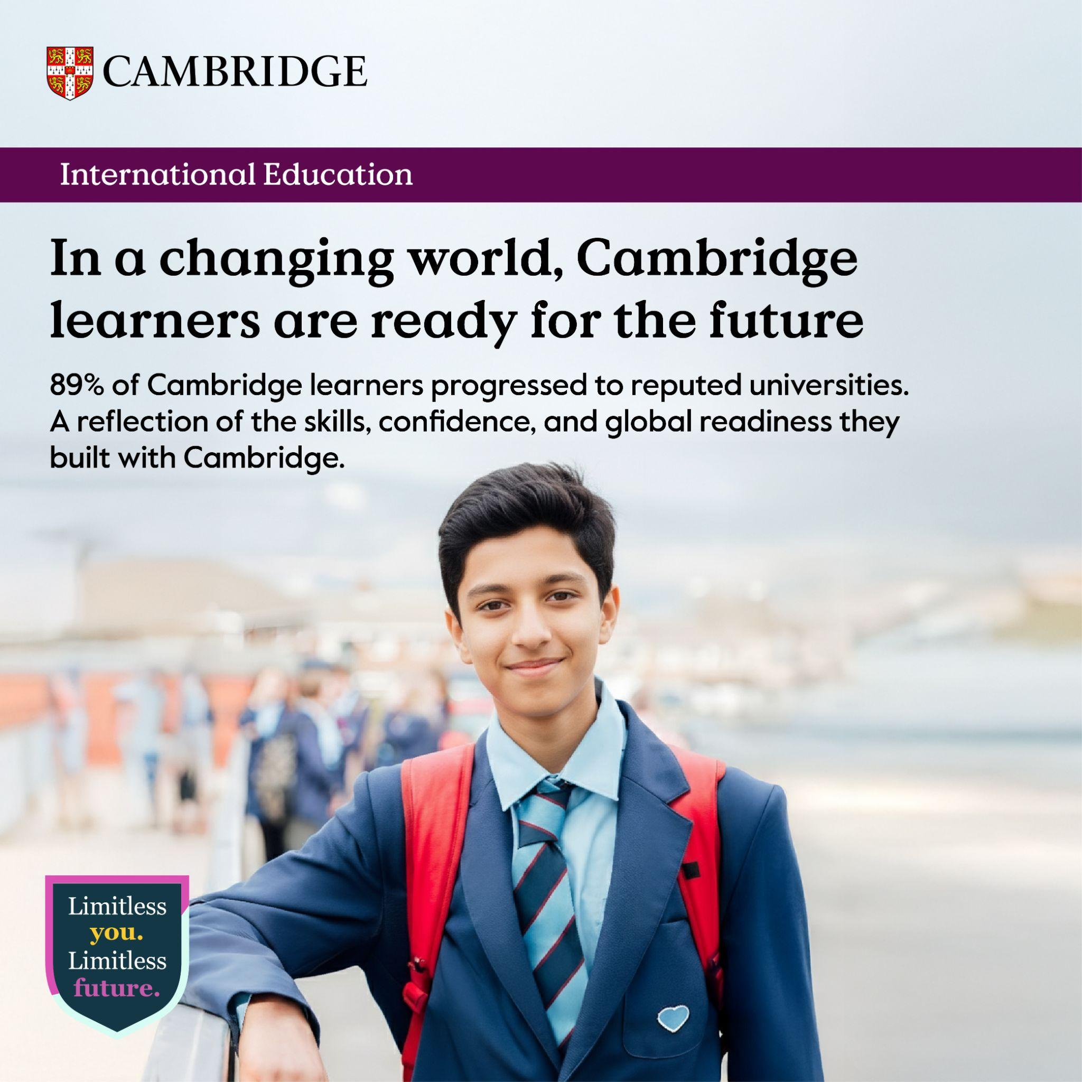
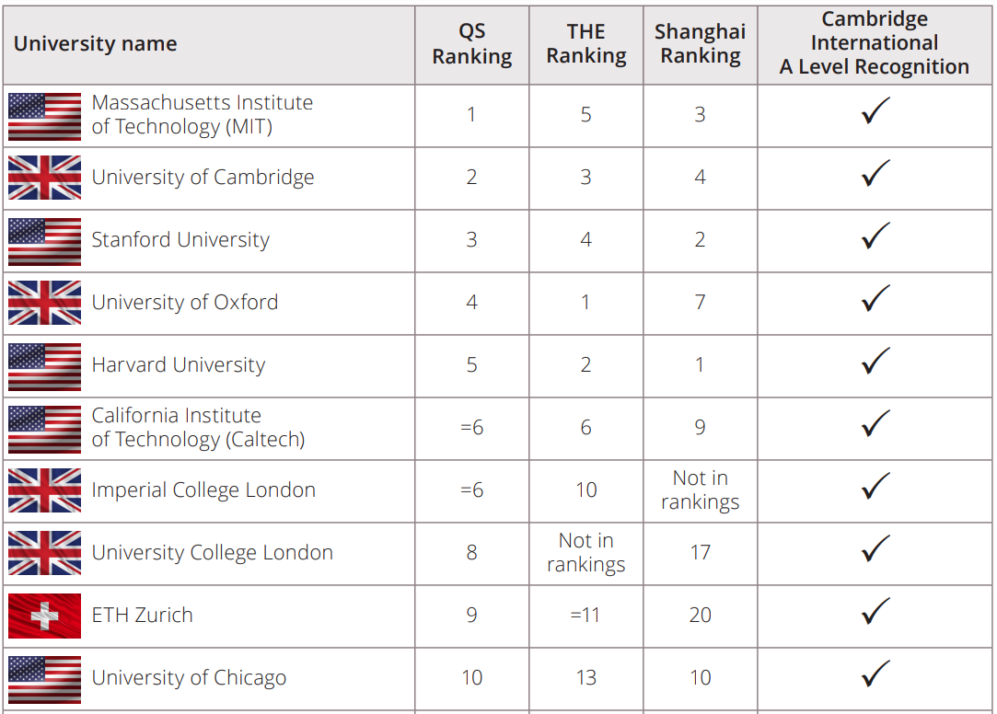
Top ranked universities recognise Cambridge qualifications

Slide 19
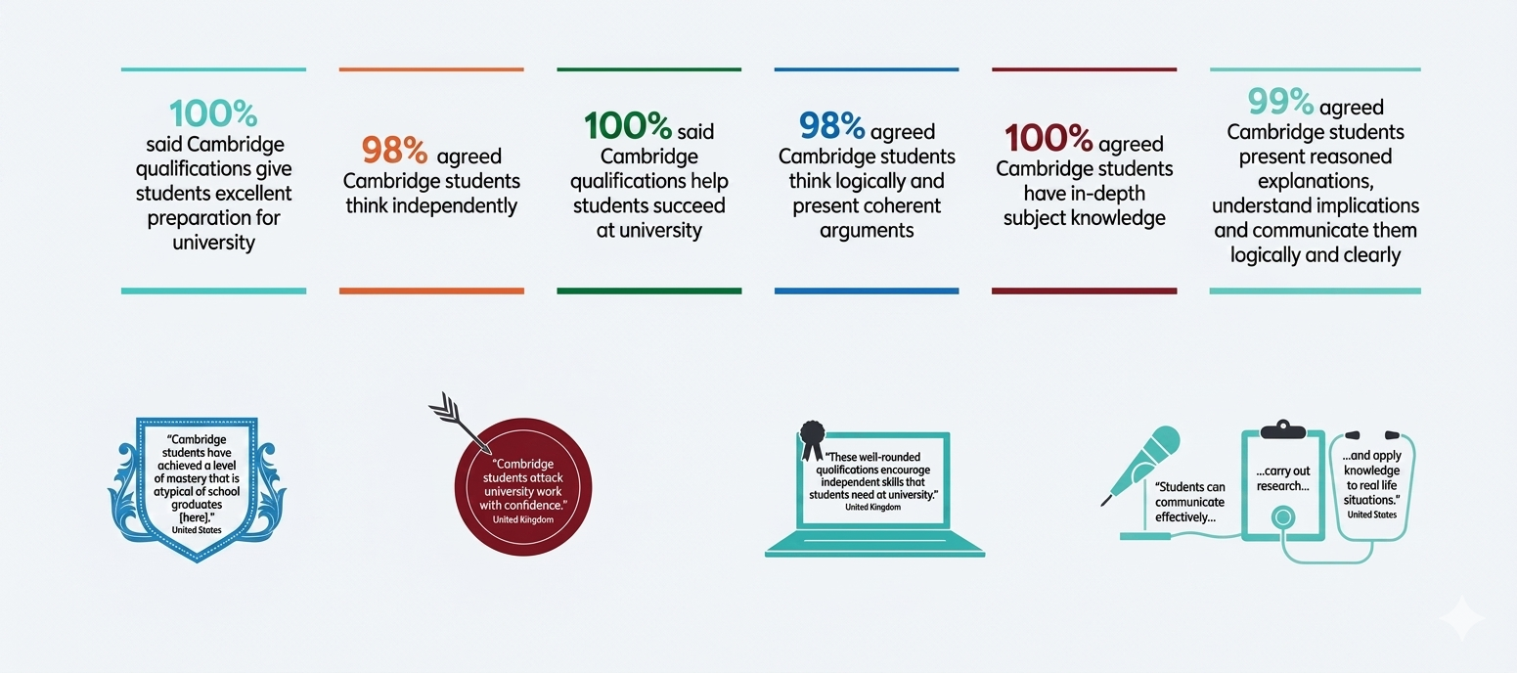
How Universities View Cambridge Qualifications

Slide 20
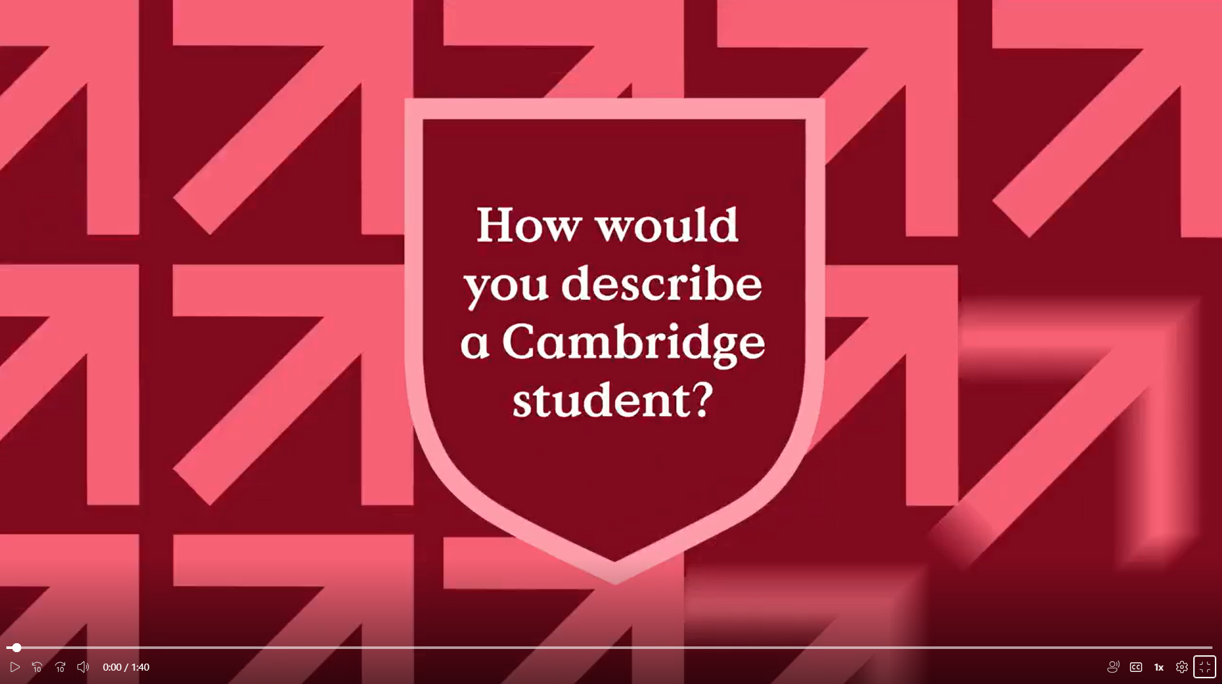
How Universities View Cambridge Qualifications
How do top universities describe Cambridge students?

Slide 21
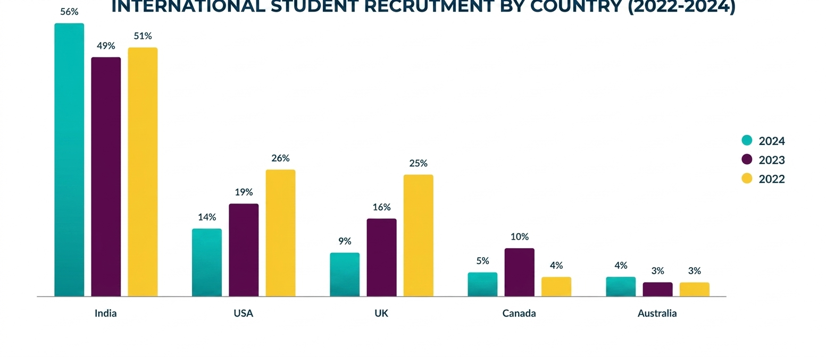
The New Geographical Reality — India is looking very attractive!
56%
of Cambridge International students stayed back in India in 2024

Slide 22
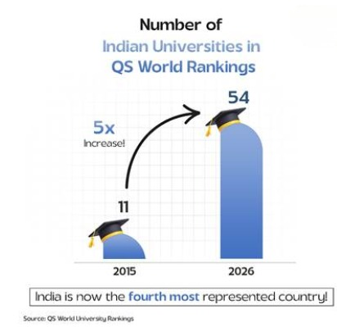
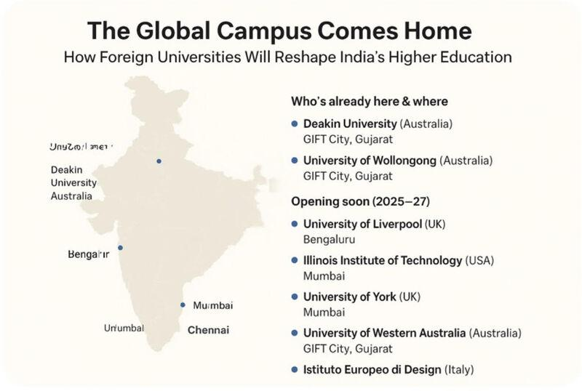

Why is India looking so attractive?
International Universities now in India:
54 Indian universities in QS World University Rankings 2026 up from just 11 in 2015, marking nearly a five-fold increase over a decade
University of Southampton (UK) — Delhi NCR
University of Bristol (UK) — Mumbai
University of Aberdeen — Mumbai

Slide 23




How do we enable students to apply to Indian Universities?
AIU Equivalence
Association of Indian Universities (AIU) has granted equivalence to Cambridge IGCSE/O Levels and A Levels
National Recognition
National and State exam boards in India recognise these qualifications as equivalent to secondary and senior secondary qualifications on the basis of AIU equivalence
Flexible Transfer
Transfer from one exam board to another is possible on a point to point equivalence basis

Slide 24


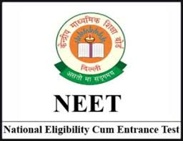


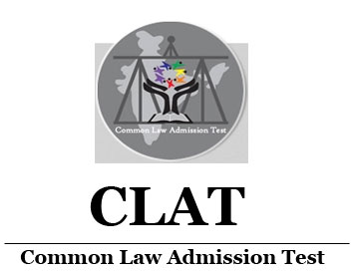

Cambridge Advantages for Indian Students
March exam series offered exclusively in India. Results are released mid May. This ensures students get their results in time to meet local university deadlines.
Flexible curriculum. No compulsory subjects or restriction on subject combinations. Students are free to select subjects as per their choice and need.
Supports preparation for national high-stakes entrance exams within Cambridge's curricular ecosystem.

Slide 25
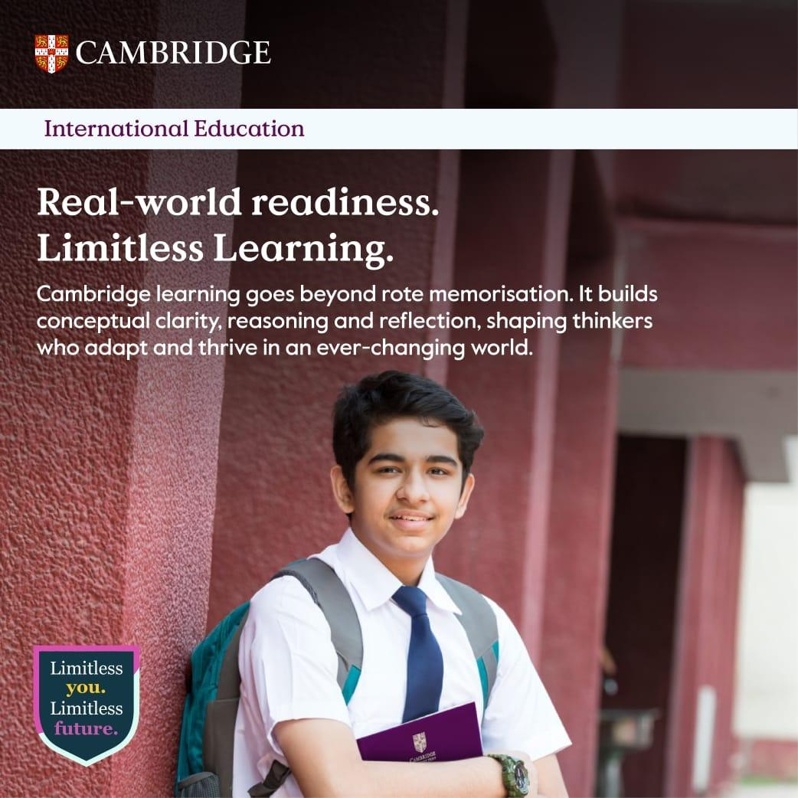
High Stakes Entrance Exams is not only about memorising formulas
It rewards students who understand why, not just what
Cambridge students already learn how to think and analyse
Transition to JEE coaching is natural, not stressful
A child trained how to learn performs better in any exam.

Slide 26
"My experience during the admissions process at IIT was very smooth though I didn't expect it. I thought there will be a problem during admission but I was glad to know that IIT Delhi UG Section knew about this curriculum and how the examinations are conducted by this board."
Parth Agrawal
Cambridge A Level student pursuing BTech Computer Science at IIT Delhi

Slide 27


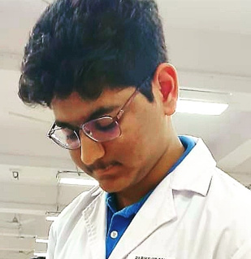
Electronics topics in A level Physics intrigued me and made me do further research about the topic and provided confidence to pursue Electronics Engineering. In the first year of engineering I realized that A level statistics is a university Level course, literally helped me in positioning against my peers. AS level English is aiding me in understanding tougher concepts in all subjects and to articulate well.
The syllabi and textbooks greatly helped my conceptual understanding of the hard sciences and mathematics. Cambridge exams involved a lot of application-oriented thinking which I feel, over the years, helped strengthen my critical thinking.
The Cambridge A level curriculum greatly improved my analytical and critical thinking skills, which were not only essential in excelling in NEET to get into the MBBS course but are extremely important in the study of medicine itself and are greatly helping me in my study at medical college.
Why
Cambridge?
Anandita Nambiar, former Cambridge A Level student pursuing MBBS at Maharashtra University of Health Sciences
Parikshit Sen, former Cambridge A Level student pursuing MBBS at Maulana Azad Medical College, University of Delhi
Shankara Narayanan, B.Tech Electrical & Electronics Engineering, BITS Pilani, Hyderabad

Slide 28
"Cambridge A Levels, with its thinking-oriented curriculum helped me hone my intellectual ability. History interpretations paper and English general paper essays particularly test one's ability to think about issues in a holistic manner. Being exposed to such a curriculum helped me in succeeding in the challenging entrance exams of India."
Sania Jaman
Cambridge A Level student pursuing 5-year Integrated Program in Management — IIM Ranchi

Slide 29
Cambridge International AS & A Level
Opening doors to a world
of opportunities

Slide 30



A Love for Learning
The programme is built around what matters most to your child as they progress through their education.
Choose from a range of 50 subjects, meaning they can study what they enjoy and are good at.
Develop a deep understanding of the subjects as well as independent learning and critical thinking skills – abilities that universities value highly.
Cambridge International AS & A Level is a two-year course, though students can complete AS Level in one year.

Slide 31

An aligned programme based on the latest research
Cambridge believes education works best when curriculum, teaching and learning, resources and assessment are closely aligned and encourage personal growth and wellbeing.
We can support your child – by providing additional guidance to build understanding and confidence, or offering stretch and challenge, helping them to reach their potential and thrive.

Slide 32

An international education
Cambridge International AS & A Levels are designed for an international audience, making them ideal for learners whose first language is not English.

Slide 33
Fair and meaningful assessments for every student
Exams taken at the end of the course – students develop a deeper understanding of subjects.
Choice of three assessment options.
Each subject receives a separate grade.
Grades are from A* to E, with A* being the highest.
Exams in November, June and March with flexibility of timing.

Slide 34
Recognised and valued worldwide
Cambridge International AS & A Levels help thousands of learners to gain places at leading universities around the world.
Cambridge qualifications open doors to a world of opportunities, helping to prepare your child with the skills they need to thrive at university and beyond.
Universities value the critical thinking skills, independent research abilities and deep subject knowledge that Cambridge learners bring.

Slide 35

A global learning community
With the Cambridge Pathway, your child is joining a global community of learners from more than 10,000 schools in over 160 countries.
By working with our wider community, our teachers can connect with other schools from around the world to share best practice.

Slide 36

"In a world of uncertainty, the strongest advantage you can give your child is not a destination — it is the ability to thrive anywhere."

Slide 37
Cambridge International Certificate in Education (ICE)
The Cambridge ICE certificate is a group award designed for schools that want to offer a broad curriculum. Students enter and sit for a minimum of seven subjects selected from the five IGCSE curriculum areas:
Group 1
Group 2
Group 3
Group 4
Group 5
Languages
Humanities
Sciences
Mathematics
Creative & Vocational
Students who qualify for the Cambridge ICE award will be placed in one of three categories:
Distinction
Merit
Pass
Grade A or better in 5 subjects and grade C or better in 2
Grade C or better in 5 subjects and grade F or better in 2
Grade G or better in 7 subjects

Slide 38
Cambridge AICE Diploma
The Cambridge AICE Diploma is made up of individual Cambridge International AS & A Levels, which are widely recognised by universities and employers around.
To achieve the Diploma, all learners will need to study and pass the revised Cambridge International AS Level Global Perspectives & Research (9239).
There are over 50 Cambridge International AS and A Level subjects to choose from across four subject groups:
Group 1
Group 2
Group 3
Group 4
Mathematics
& Sciences
Languages
Arts &
Humanities
Interdisciplinary
(optional)
Learners must achieve at least one credit from each of Groups 1, 2 and 3. A maximum of two credits can count from
Group 4, which is optional.

Slide 39

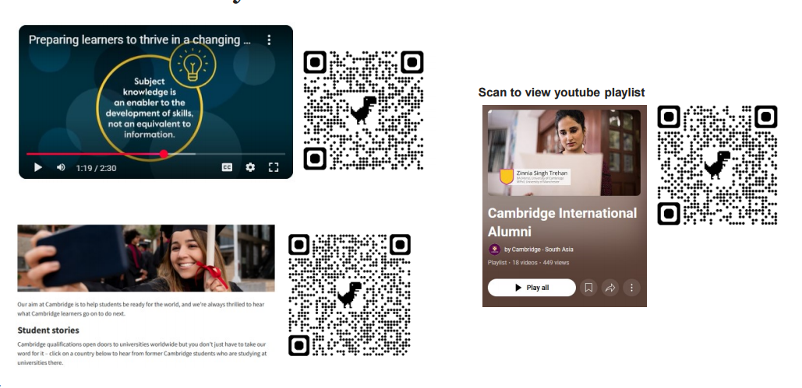

Practical Resources for Schools and Parents!

